Slide 1
COVID-19 forecasting in the US
Rimsky Ho

Slide 2

Overview
Aims and Business Value
Data Collection and Preprocessing
Data Analysis
Machine Learning Models
Hyperparameter Optimisation
Insight Analysis
Challenges and Limitations
Conclusion

Slide 3

Aims
What kind of data am I looking for?
What am I going to do with the data?
Why am I doing this?
What kind of results am I expecting?

Slide 4


Business Value
Foreign and/or multinational corporations
Insurance companies
Hospital authorities

Slide 5


Data Collection
Centers for Disease Control and Prevention (CDC)
COVID Data Tracker
URL: https://covid.cdc.gov/covid-data-tracker/#datatracker-home

Slide 6
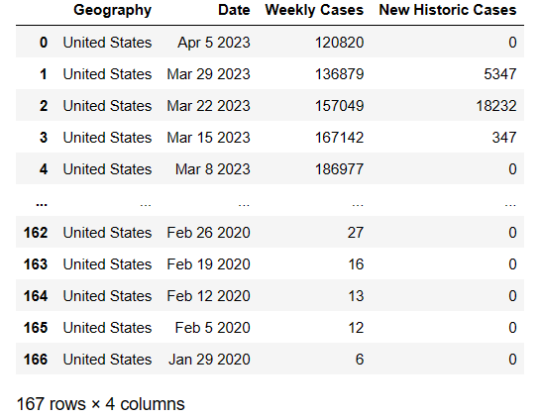
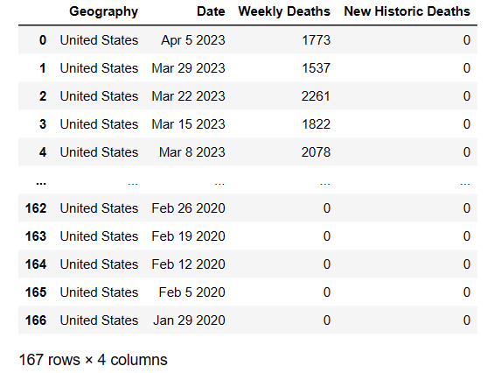
Data Preprocessing - Initial dataframes (Weekly Cases and Deaths)

Slide 7
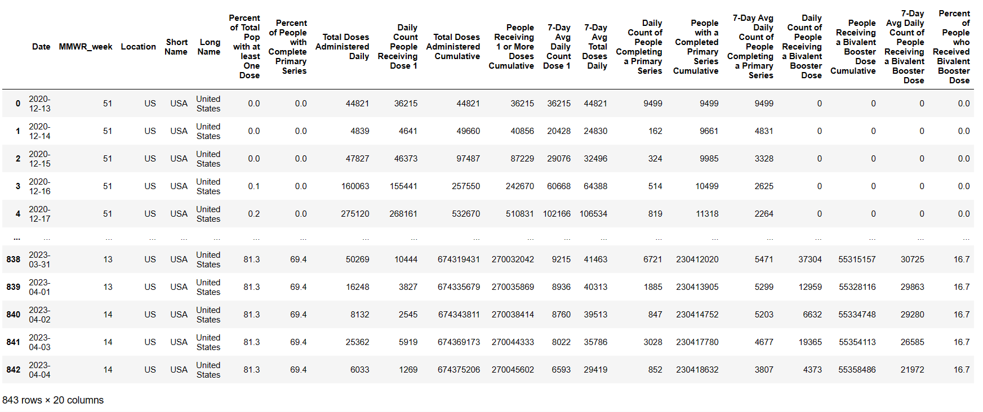
Data Preprocessing - Initial dataframes (Vaccination data)

Slide 8
Data Preprocessing - Columns
‘Date’
‘Weekly Cases’
‘Weekly Deaths’
‘Total Cases’
‘Total Deaths’
‘Weekly Vaccinations’ (converted from ‘Total Doses Administered Daily’)

Slide 9
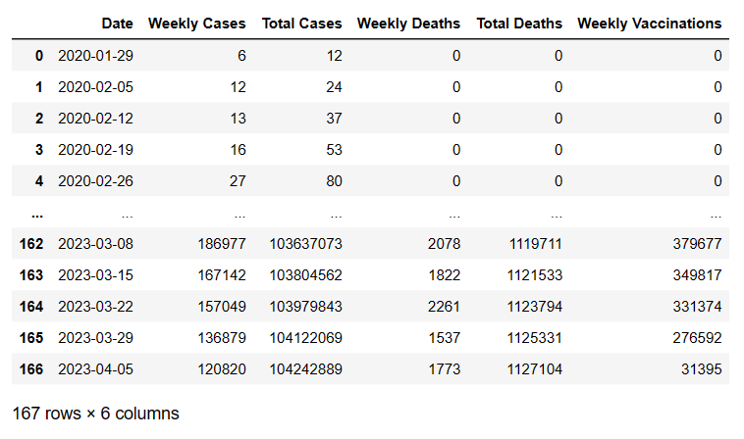
Data Preprocessing - Final DF

Slide 10
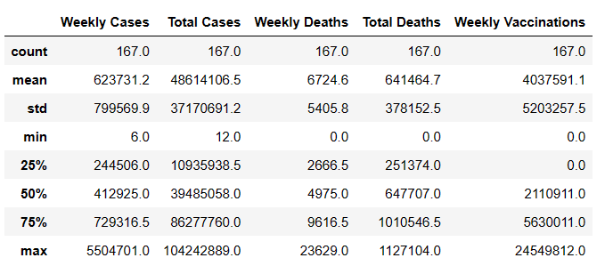
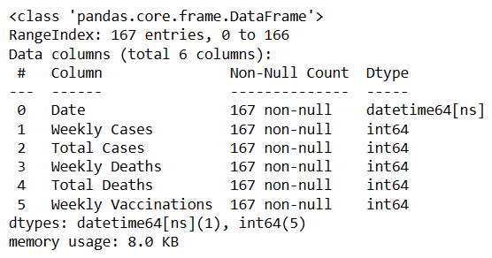
Analysis - dataframe statistics
df.describe()
df.info()

Slide 11
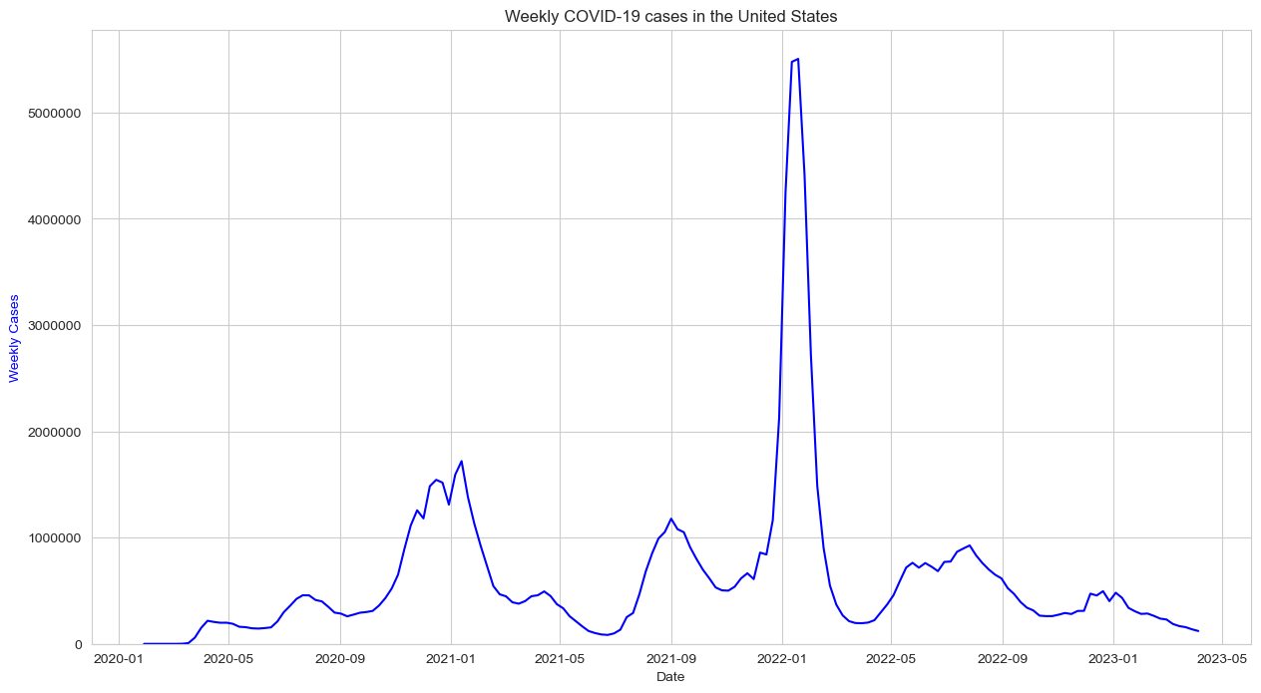

Slide 12
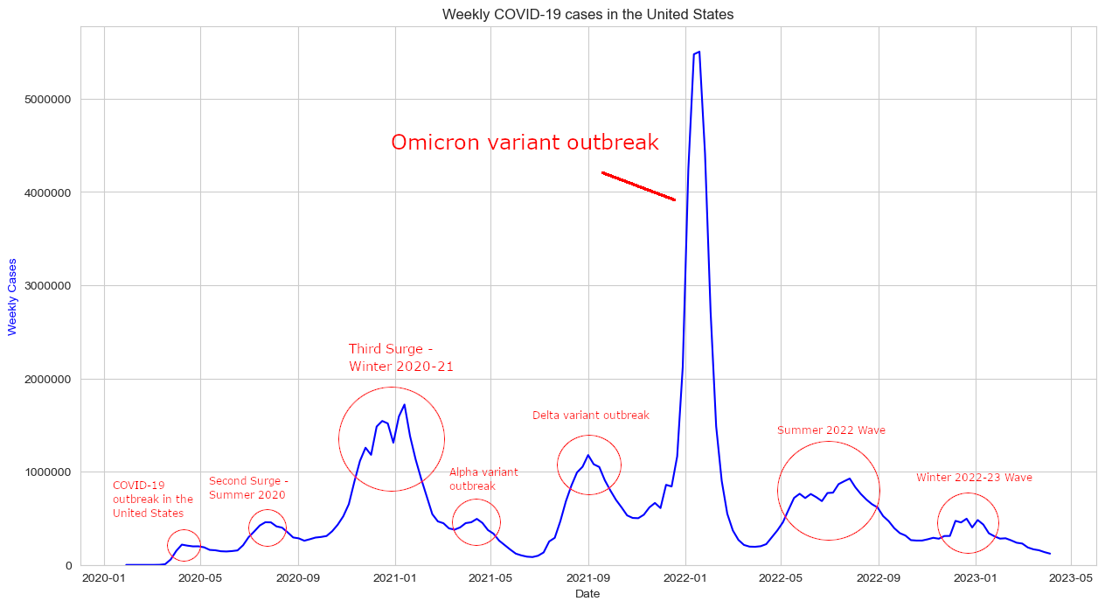

Slide 13
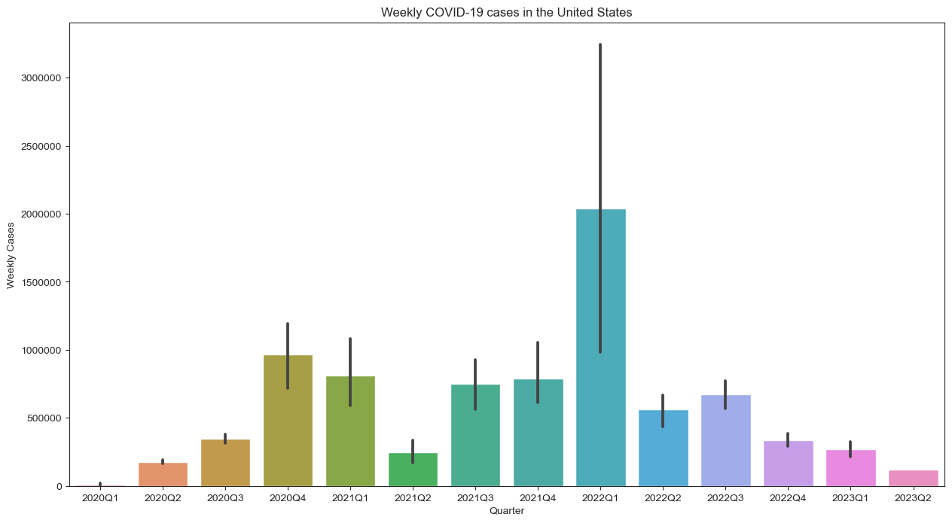

Slide 14
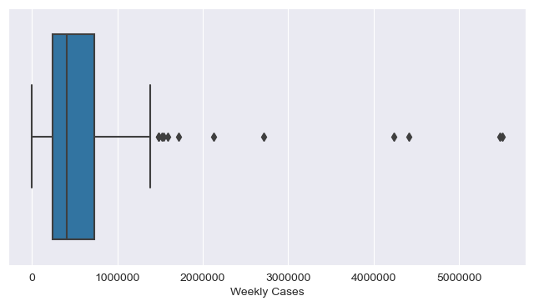
Analysis - Outliers in Weekly Cases

Slide 15
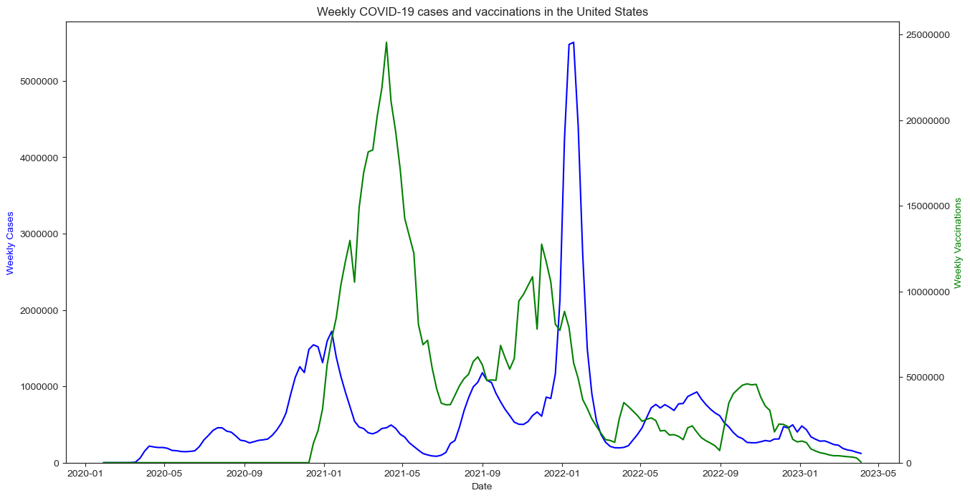

Slide 16
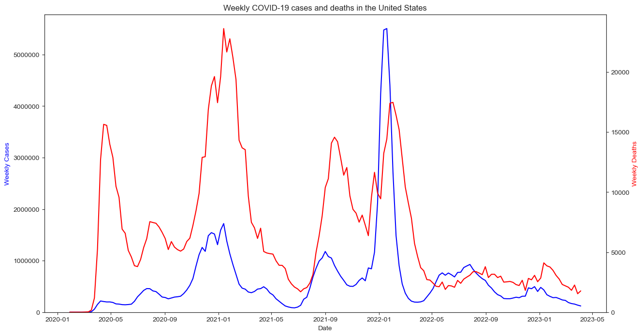

Slide 17
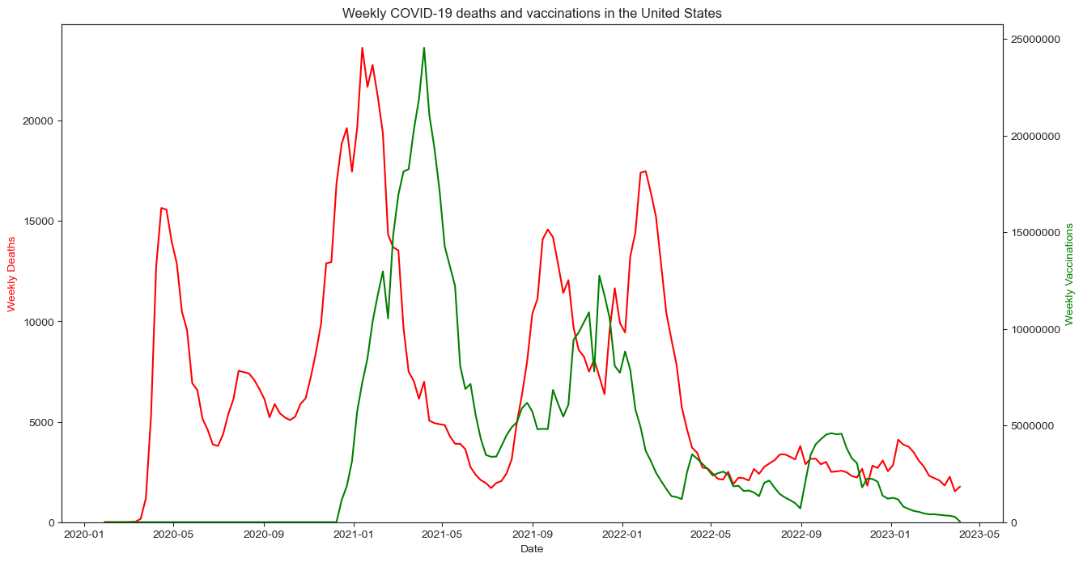

Slide 18
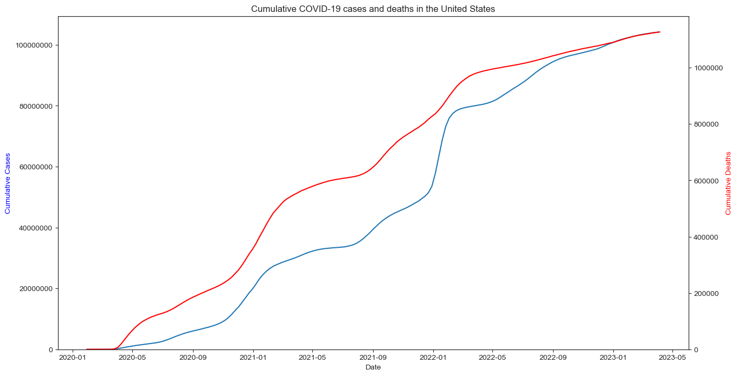

Slide 19
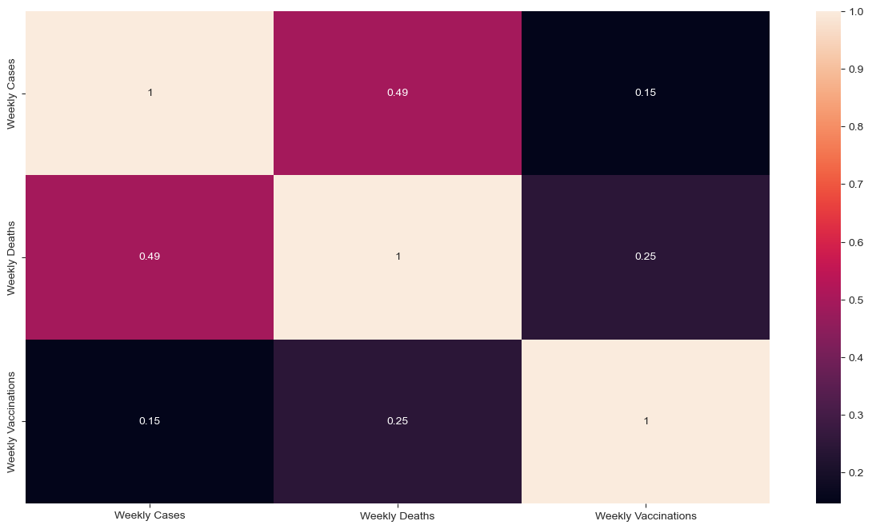
Correlation (includes data before vaccination was available)

Slide 20
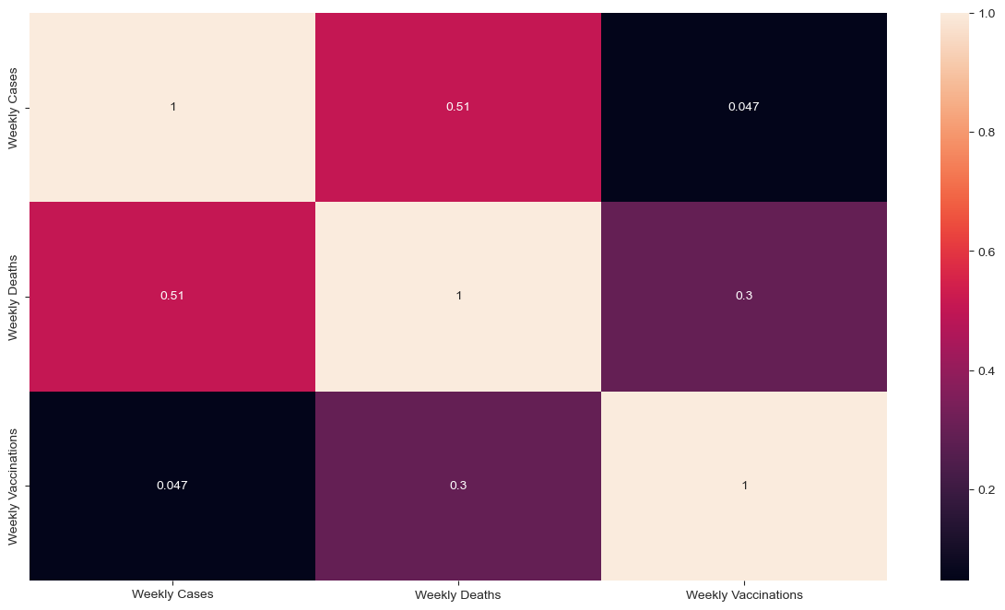
Correlation (includes only data after vaccination was available)

Slide 21

Machine Learning Algorithm
Facebook Prophet (Time Series)

Slide 22
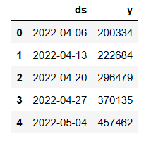
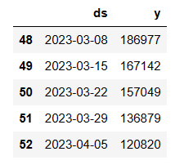
Prophet - dataframe
df.head()
df.tail()

Slide 23
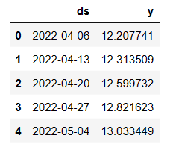
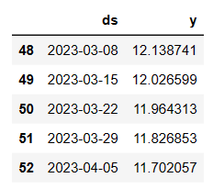
Prophet - dataframe (log-transformed)
df.head()
df.tail()

Slide 24

Prophet - Performance Metrics
Default - MAPE 39.12%
Log transformation - MAPE 2.61%

Slide 25
Hyperparameter Optimisation
changepoint_prior_scale: Ranges from 0.001 to 0.5. Default 0.05. Determines trend flexibility.
seasonality_prior_scale: Ranges from 0.01 to 10. Default 10. Determines seasonal flexibility.
holidays_prior_scale: Ranges from 0.01 ~ 10. Default 10. Determines holiday flexibility.
seasonality_mode: Either additive or multiplicative. Default additive. Determines whether the magnitude of seasonal fluctuations grows with that of the time series.

Slide 26
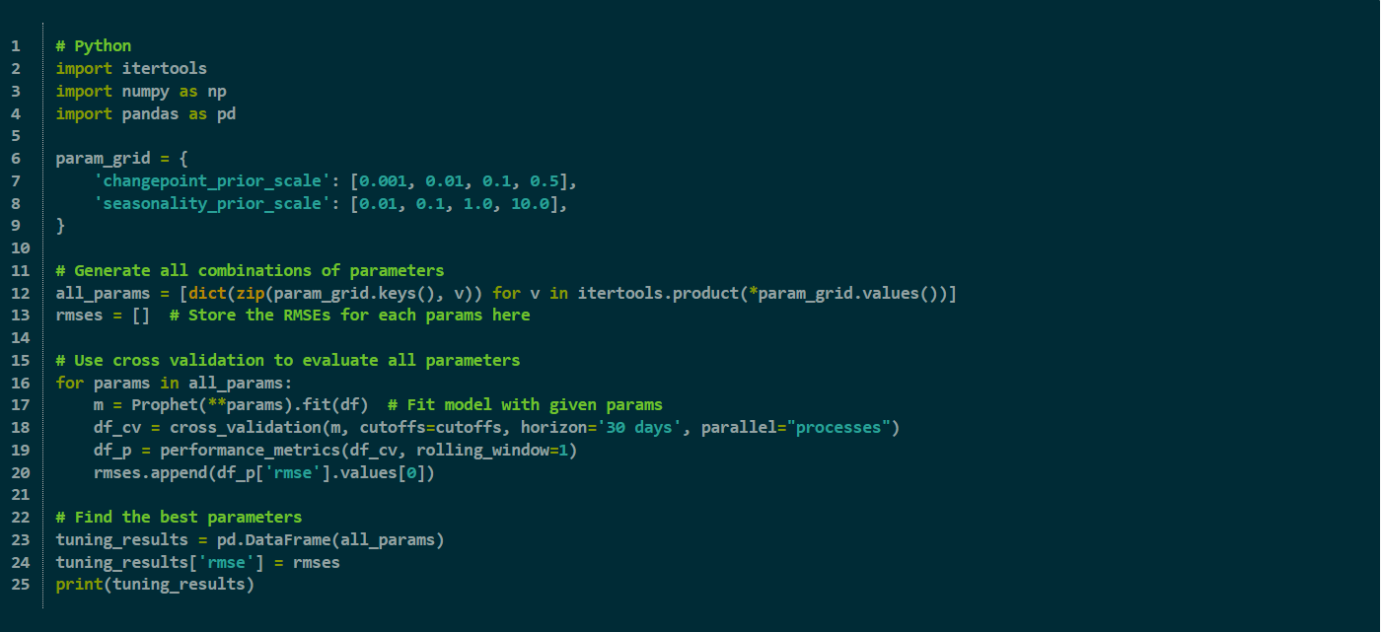
Hyperparameter Optimisation (automatically via parameter grid)

Slide 27

Hyperparameter Optimisation
changepoint_prior_scale: 0.5
seasonality_prior_scale: 0.01
With a Root Mean Squared Error of 0.381 and a Mean Absolute Percentage Error of 2.232%, this is the most optimised model for the log-transformed data.

Slide 28
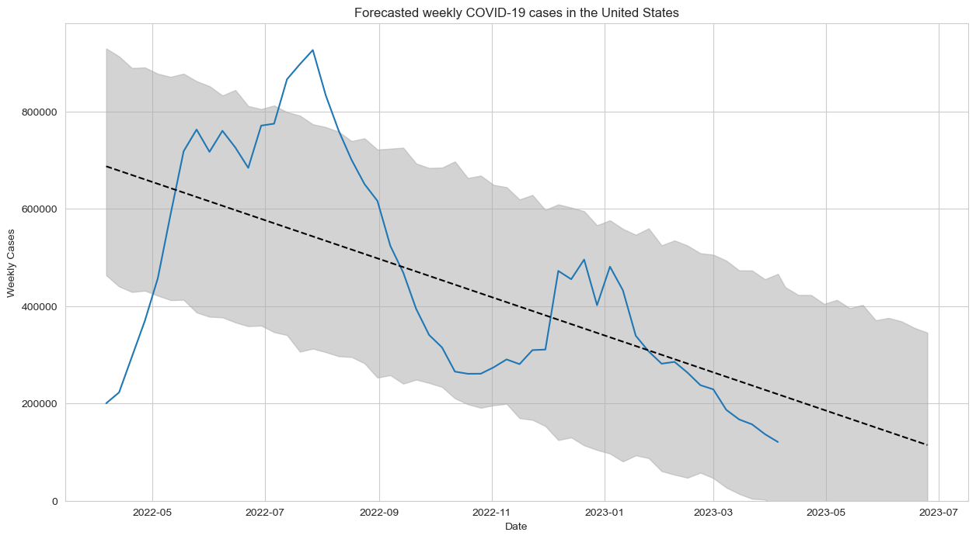

Slide 29
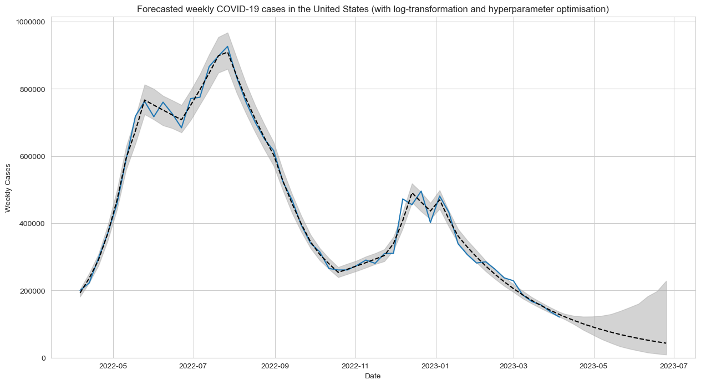

Slide 30

Insight Analysis
Trend moving downwards overall
Time series forecasting appears to be fairly reliable, but accuracy will diminish for predictions that are further in the future
Since the pandemic has been trending downwards globally for the most part, weekly cases can remain low for some time given that proper hygienic guidelines are thoroughly followed by the majority of the populace
Cases likely to go up again in winter due to cold weather weakening people’s immune systems

Slide 31

Challenges and Limitations
New variant outbreaks and waves can be unpredictable and result in a significant jump in weekly cases, causing irregularity in time series data
Widespread vaccination has a direct impact on the correlation between all weekly variables (cases, deaths, and vaccinations), thus machine learning results will also vary wildly depending on which time period you choose to train it on
Transmission rates, death rates, and vaccination rates vary between countries, and thus other models could potentially be better when forecasting other countries
Hyperparameter tuning can take a long time

Slide 32

Conclusion
Covid-19 case metrics can be predicted to some extent assuming that transmission rates remain stable
Useful for foreign companies wanting to decide whether it’s safe enough to do business in the US
Especially useful for stakeholders in the medical industry so resources can be made available ahead of time to aid COVID-19 patients
Highly volatile and susceptible to sudden, highly transmissible waves that can’t be accounted for in forecasting

Slide 33

Thank you!

